Slide 1


Shree Swami Atmanand Saraswati Institute Of Technology
PRESENTATION ON : ScrapDeal
PRESENTED BY: CHINTALA RAHULSAI(170760107009) DESAI SHUBH(170760107010) DESAI SMIT(170760107011) GADHIYA JENIS(170760107014) SIDDHAPURA YASH(170760107055)
GUIDED BY : Prof. Drashti J. Chauhan

Slide 2
Project Definition
ScrapDeal is a web-application that will allow users to sell their scraps without going anywhere.
Using it customers can sell their scraps with time and resource optimization.
It also allows more secure transaction using wallet.
This project is mainly designed using ReactJs and MongoDB.

Slide 3
Problems Faced Today
Customers have to search for shops of scrap purchasers.
They have to settle for cost lesser than that can be given.
Users have to utilize their resource i.e. Fuel to go to the shops.
Sometimes customers have to wander and visit more than one shop for getting best price for their scrap.

Slide 4
Solution Provided By ScrapDeal
1. This system will manage scrap by
picking it up from door to door.
2. This system will provide functionality
to vendors or scrap collector to pick
up scrap from any address.
3. People who want to sell scrap, can
see rate of different type of scrap like
paper, plastic, metal, E-waste etc and
can add weight of scrap.

Slide 5
Continue…
4. No Fuel and Lesser Time will be
utilized as user don’t have to go
anywhere for selling their scrap.
5. It will provide best price for each type
of scrap.
6. User will be able to sell their all scrap
in one round only.

Slide 6
Learning Required for this Project
React
Redux
Ssas
Npm Package Manager
Functional Component
Hooks
Lifecycle Methods
NodeJs
ExpressJs
MongoDB
Rest API

Slide 7
Software Required to execute ScrapDeal
Vscode
Npm
NodeJs
Yarn
Nvm
MongoDB-server
MongoDB-compass
Postman
Git

Slide 8
Software Required to use ScrapDeal
Operating System
Windows XP / Windows 7 / Windows Vista / later.
Web Browser
Microsoft Internet Explorer / Mozilla / Google Chrome / any other.
CPU
Intel or AMD processor with 32/64 bit support; Recommended to have 2.2 GHz or faster processor.

Slide 9
Hardware Required to use ScrapDeal
Laptop
Personal Computer
Internet Components
If uses WIFI then all components should work properly in order to use this web-app.

Slide 10
Modules of the System
1.Admin
This module is used by the admin to look over the details of scrap.
2.Garbage or Scrap Collector
Scrap collector will use this module to check their work to be done and collect money from wallet.
3.Customer
Customer will use this module to request for selling of their scrap.

Slide 11
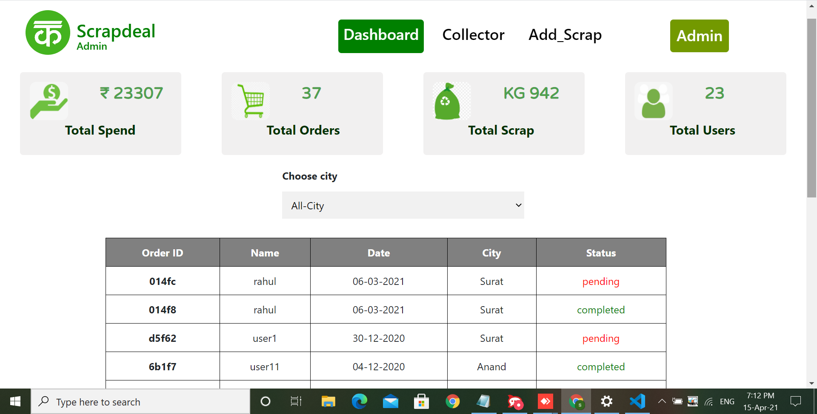
Admin Module

Slide 12
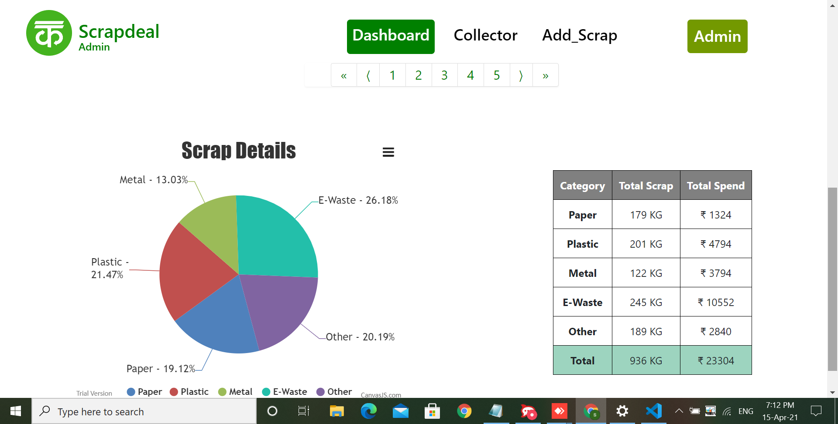
CONTINUE…

Slide 13
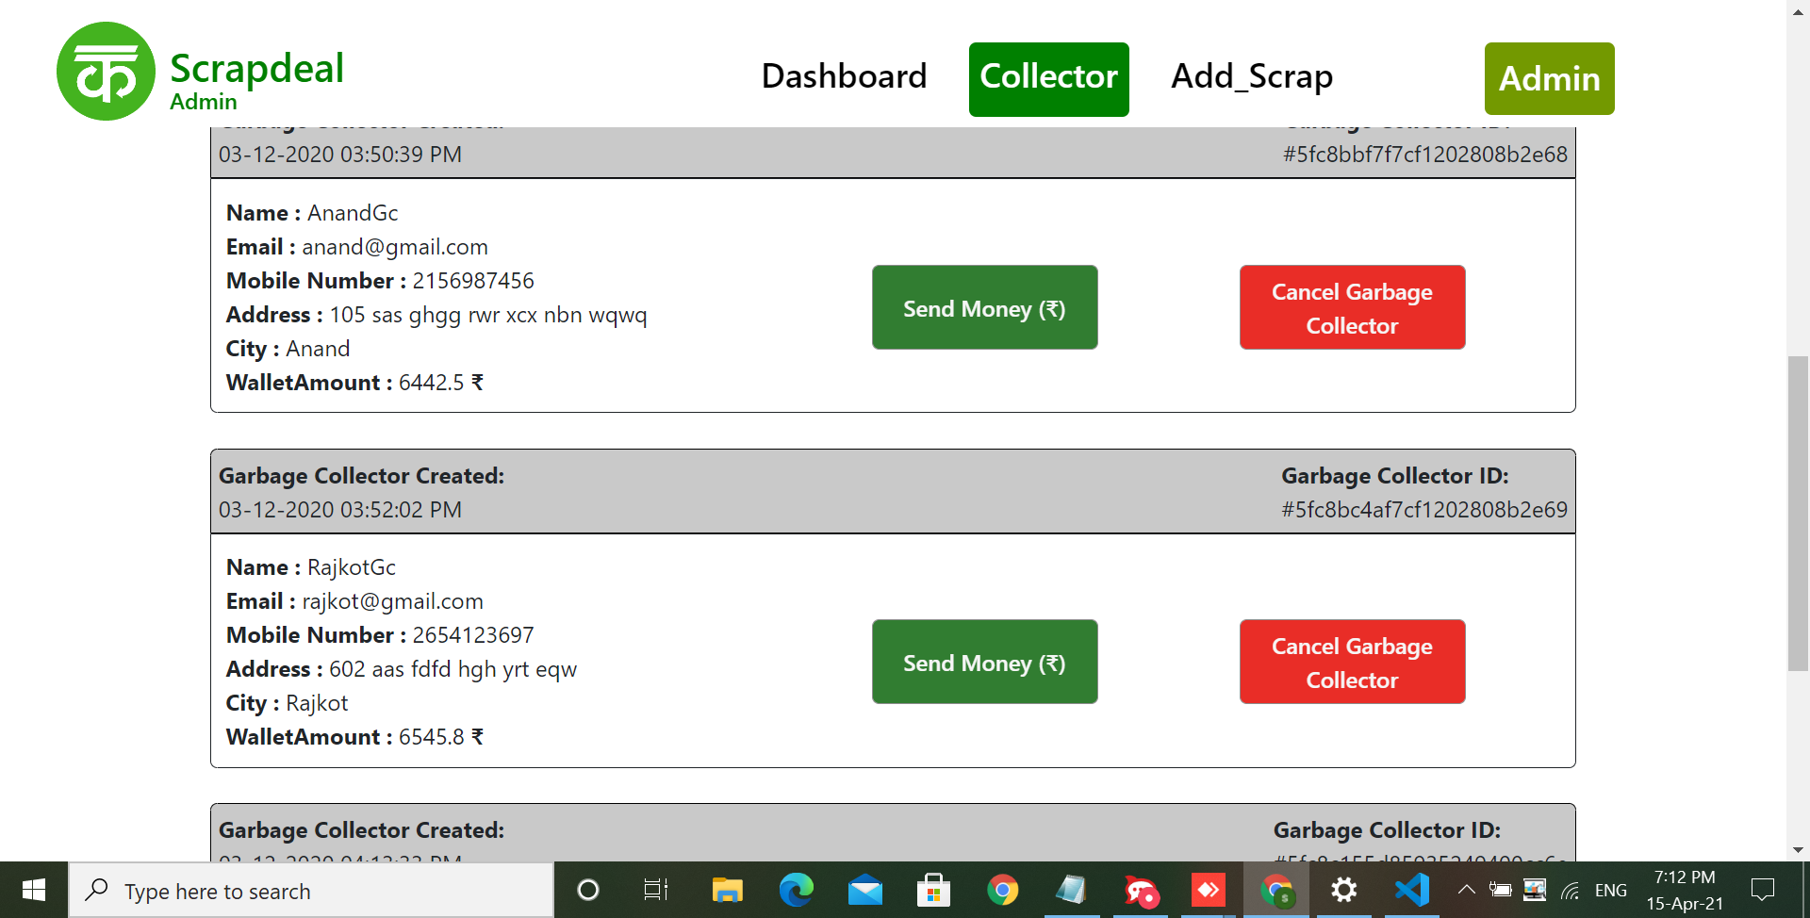
CONTINUE…

Slide 14
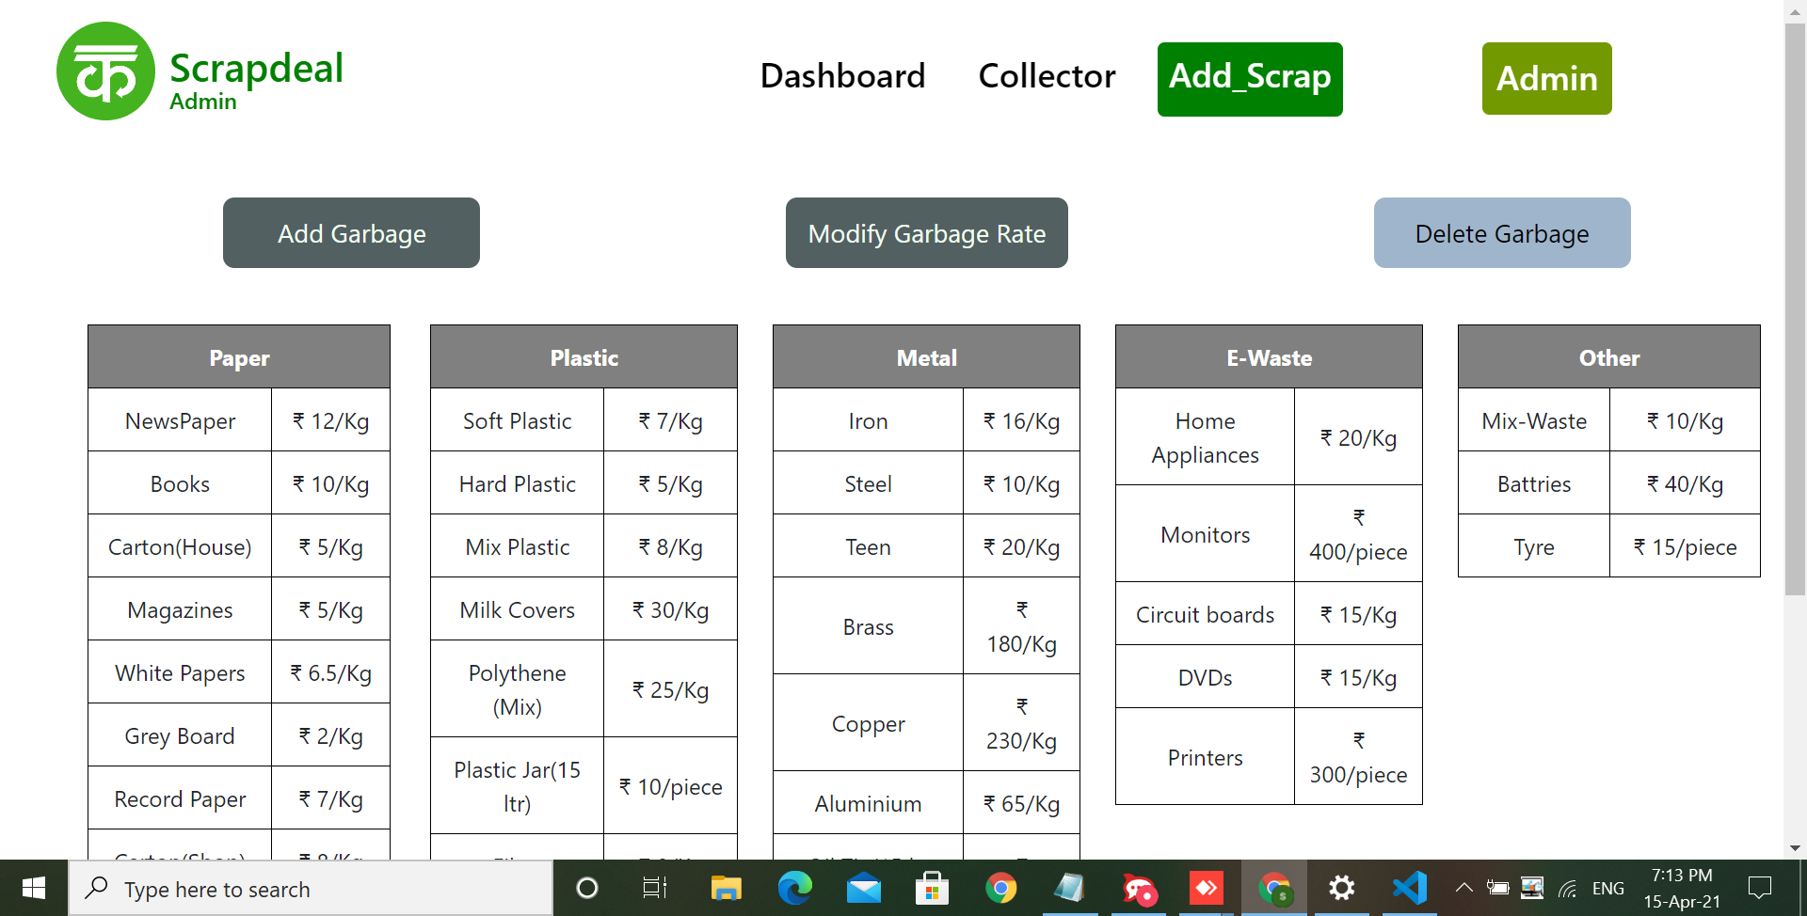
CONTINUE…

Slide 15
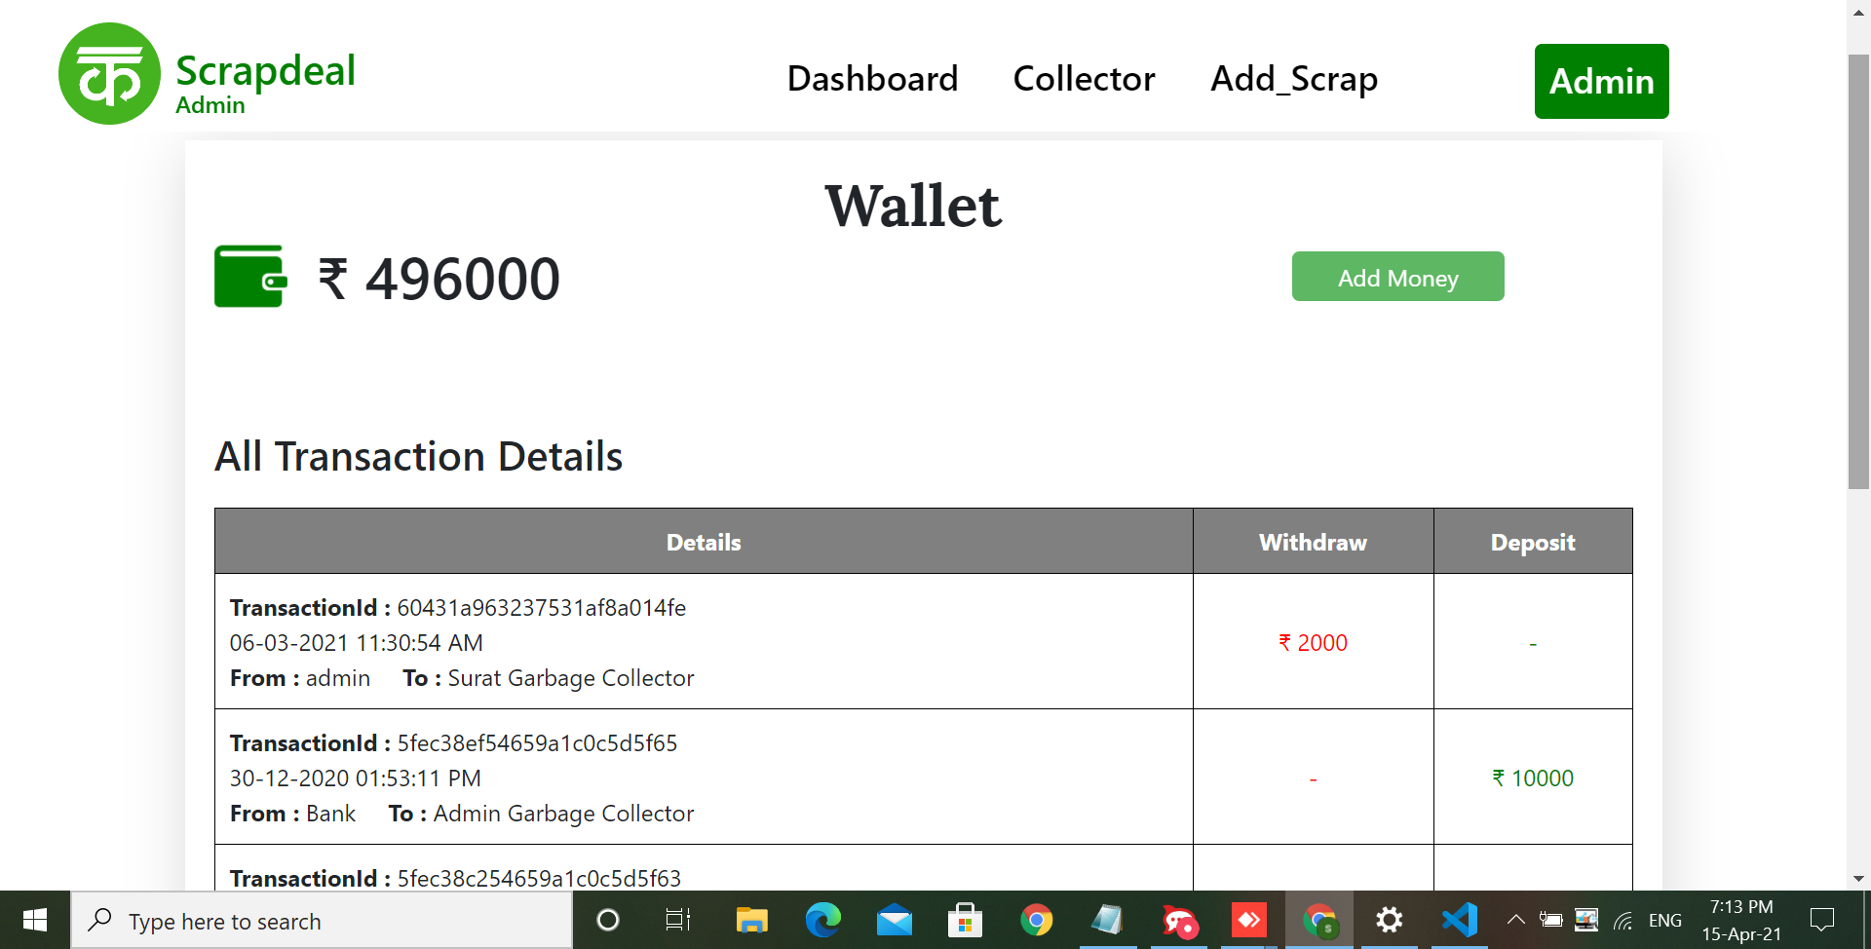
CONTINUE…

Slide 16
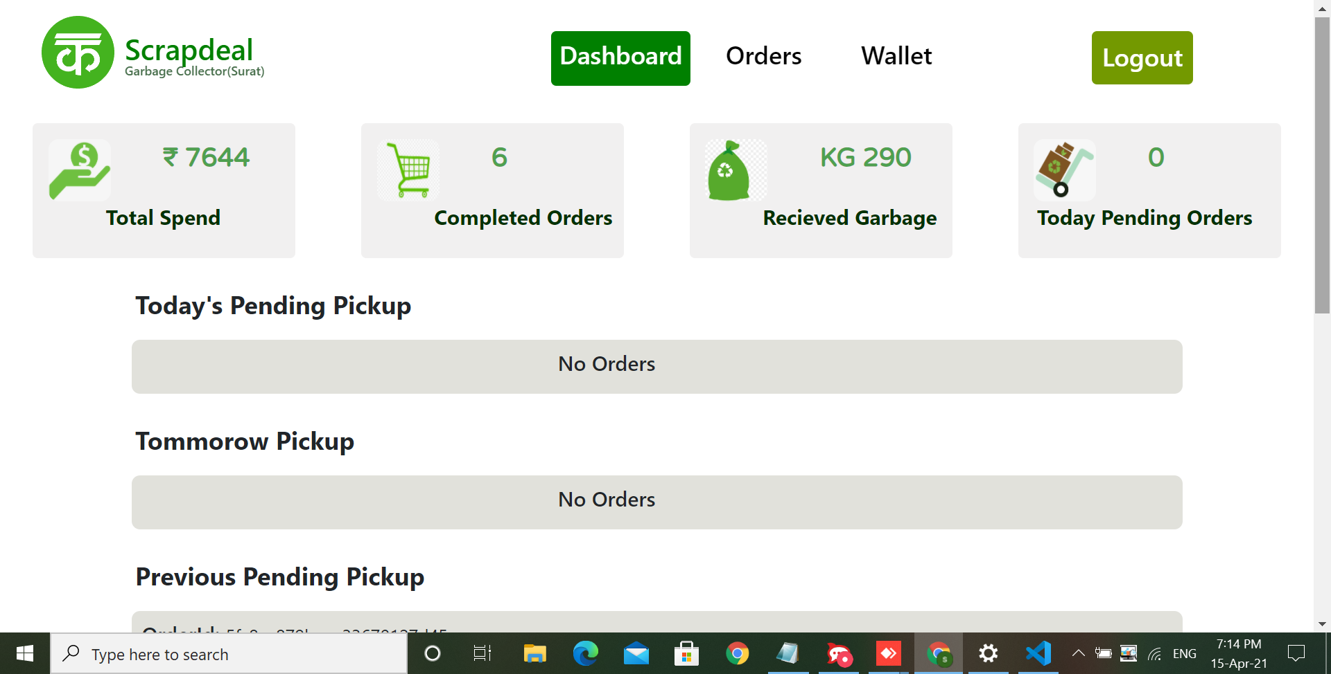
Scrap Collector Module

Slide 17
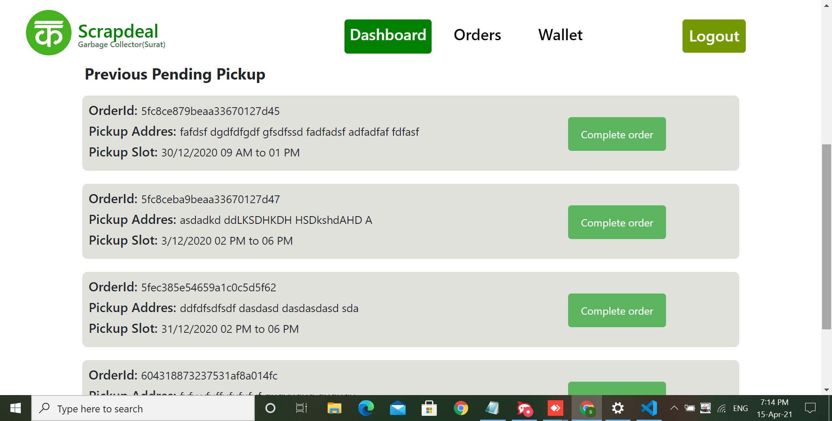
CONTINUE…

Slide 18
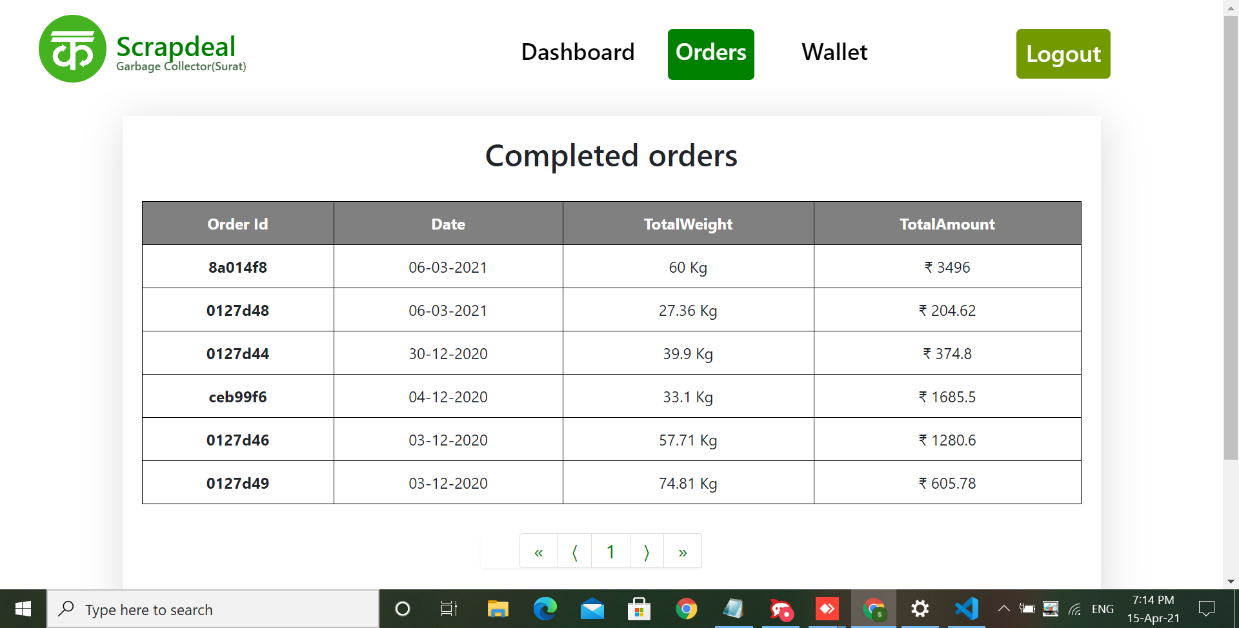
CONTINUE…

Slide 19
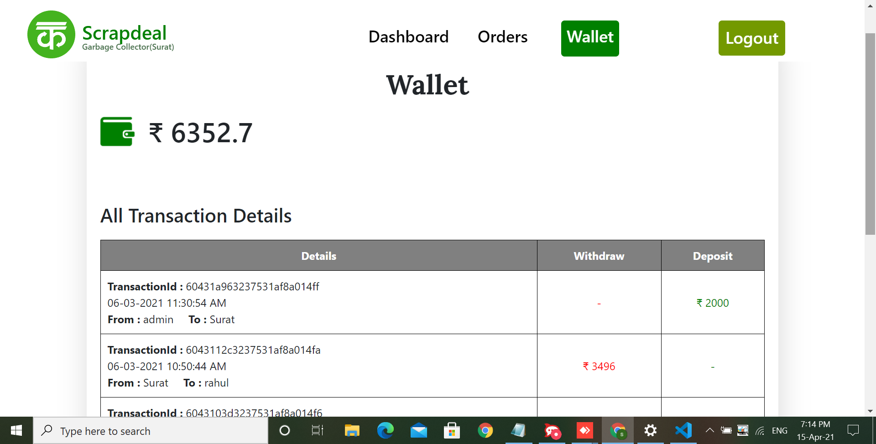
CONTINUE…

Slide 20
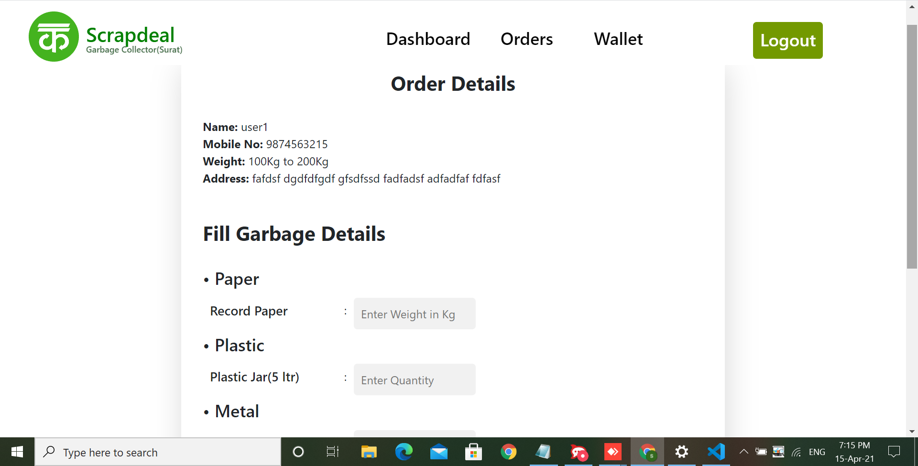
CONTINUE…

Slide 21
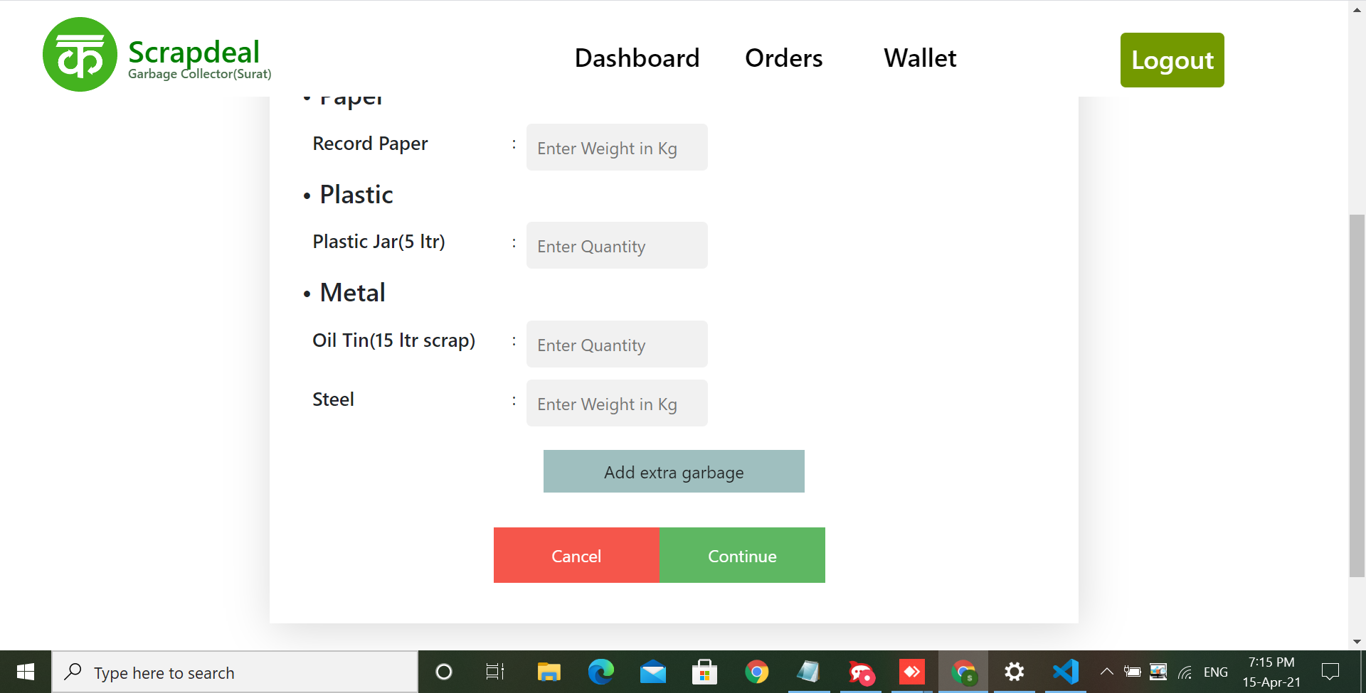
CONTINUE…

Slide 22
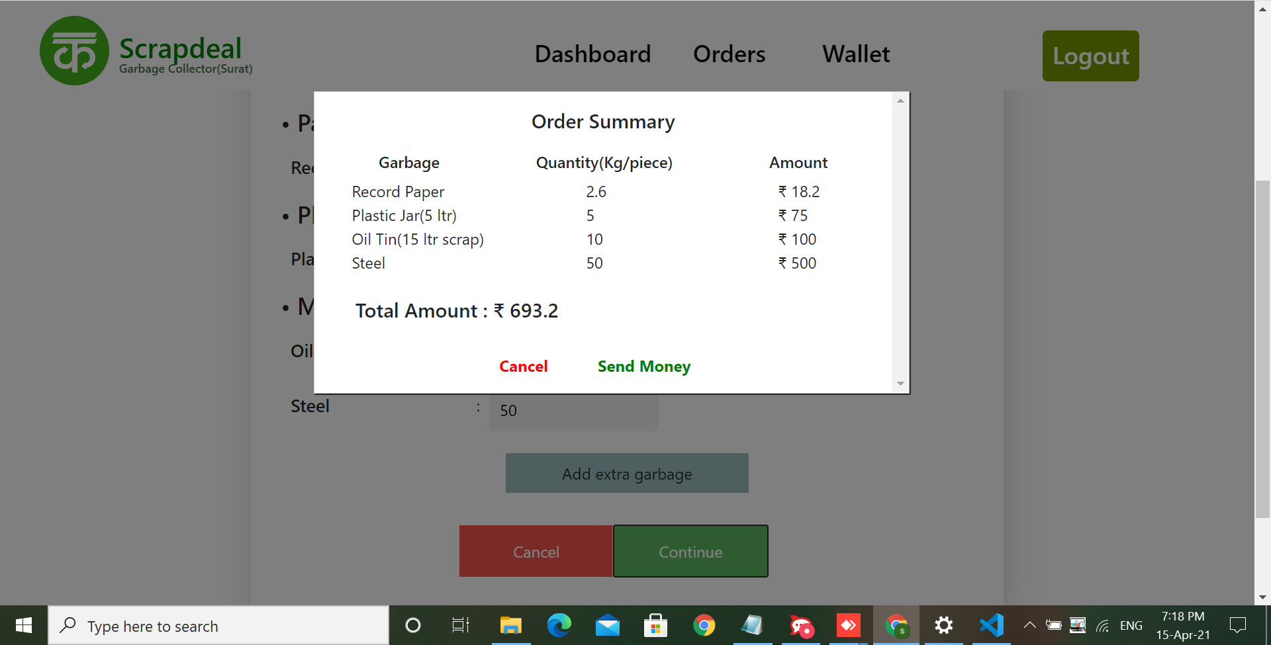
CONTINUE…

Slide 23
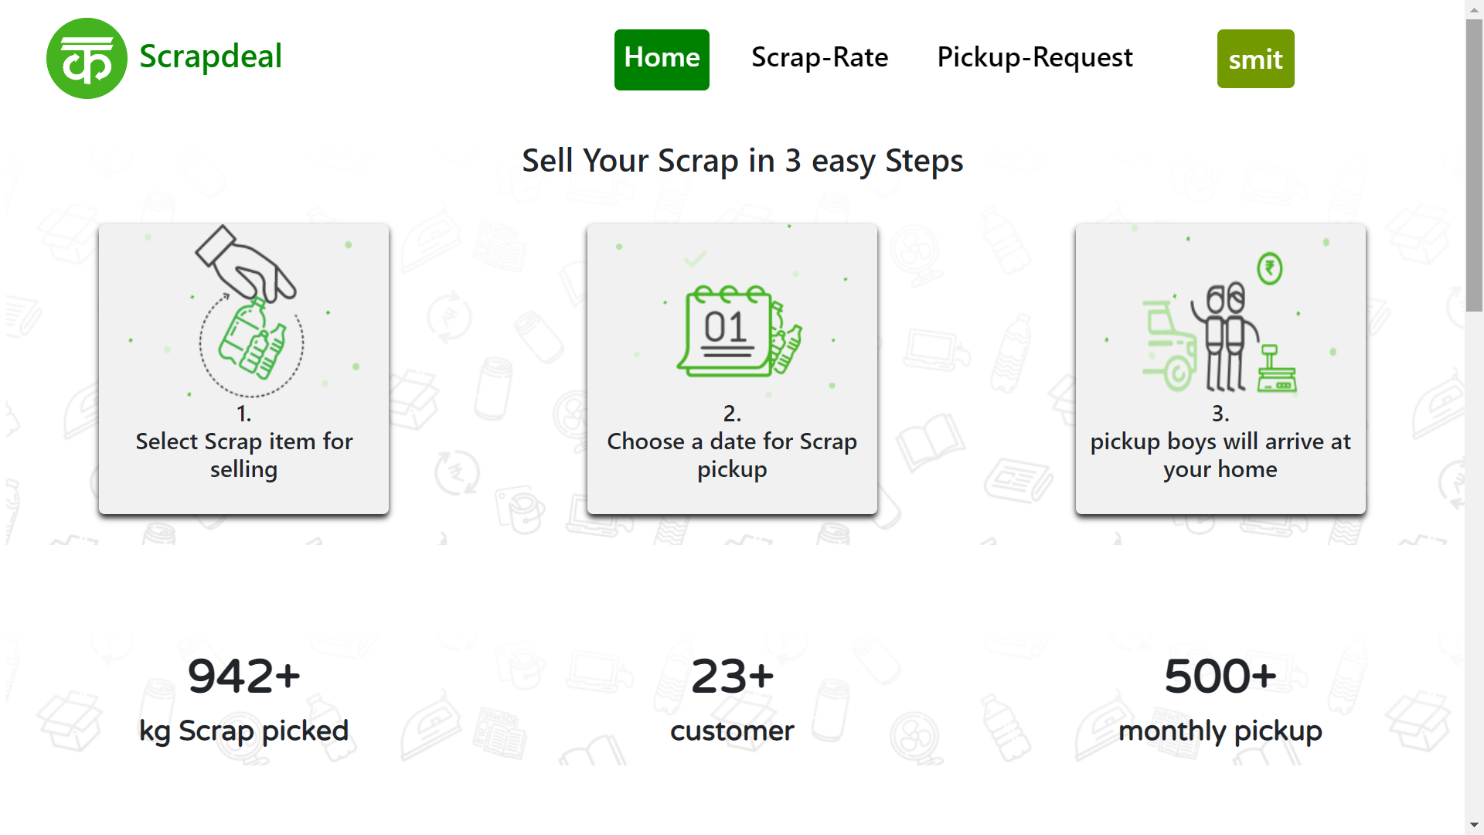
Customer Module

Slide 24
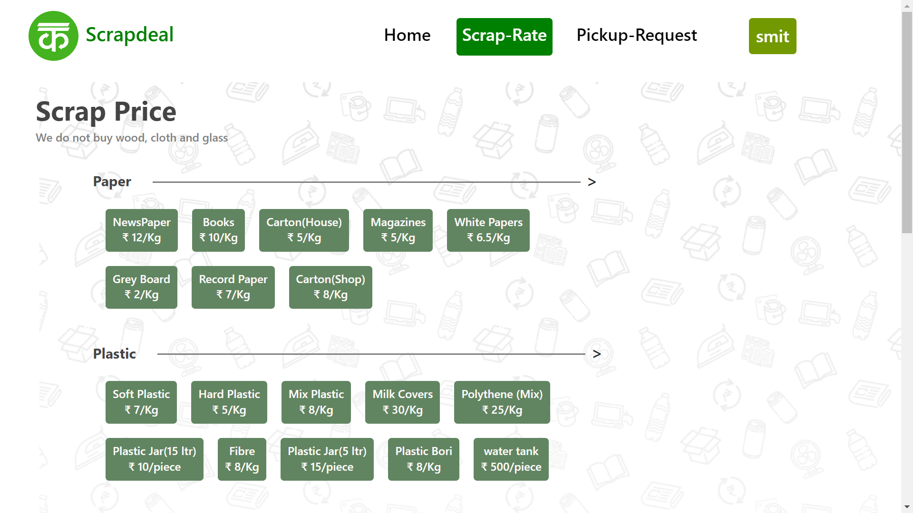
CONTINUE…

Slide 25
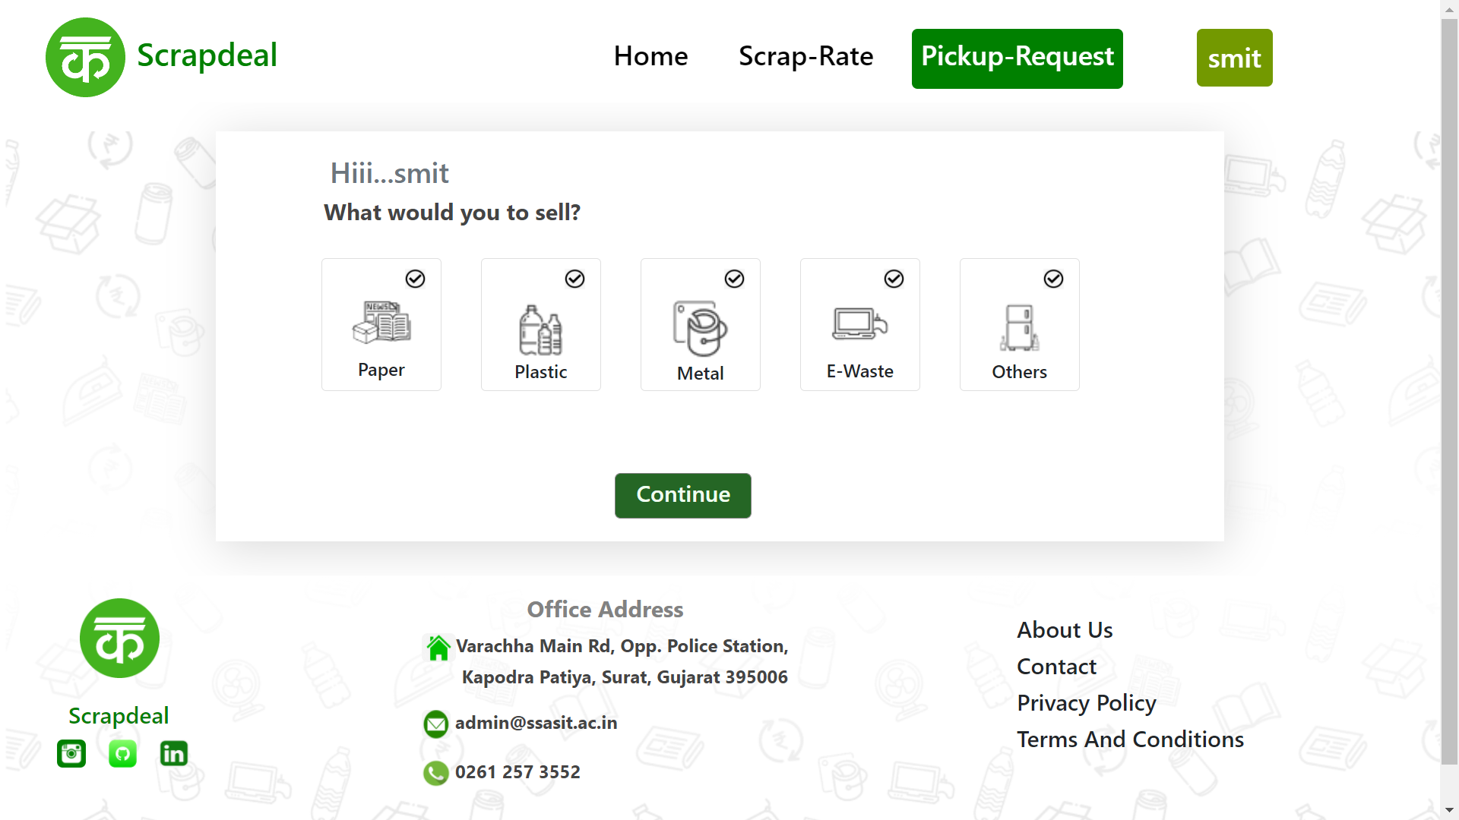
CONTINUE…

Slide 26
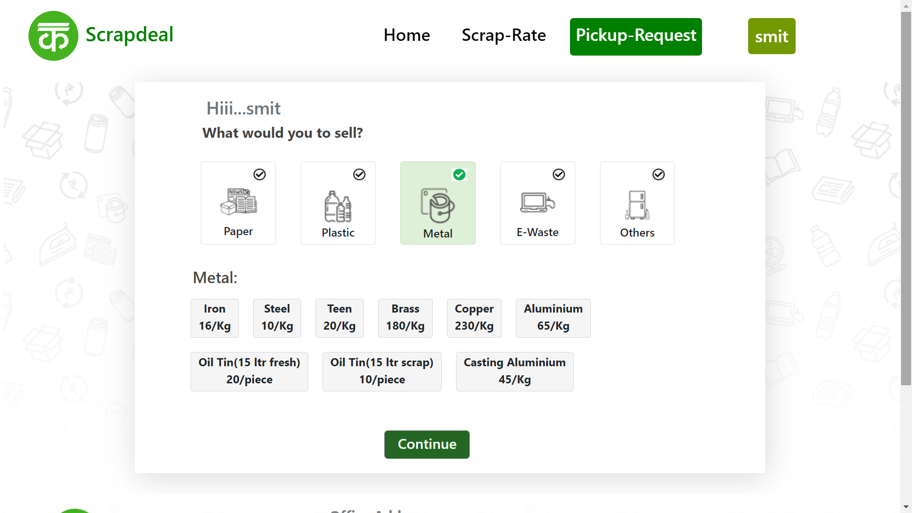
CONTINUE…

Slide 27
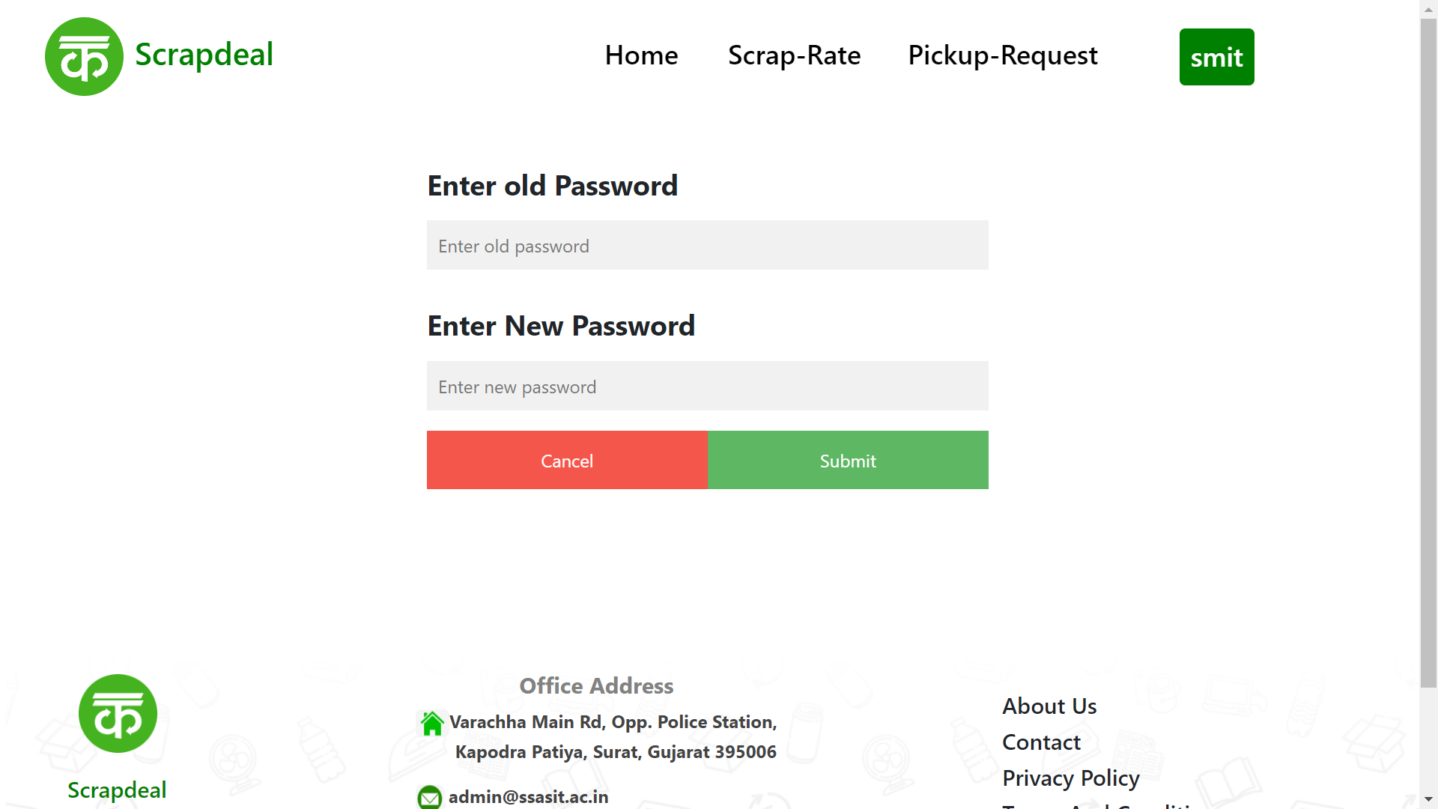
CONTINUE…

Slide 28
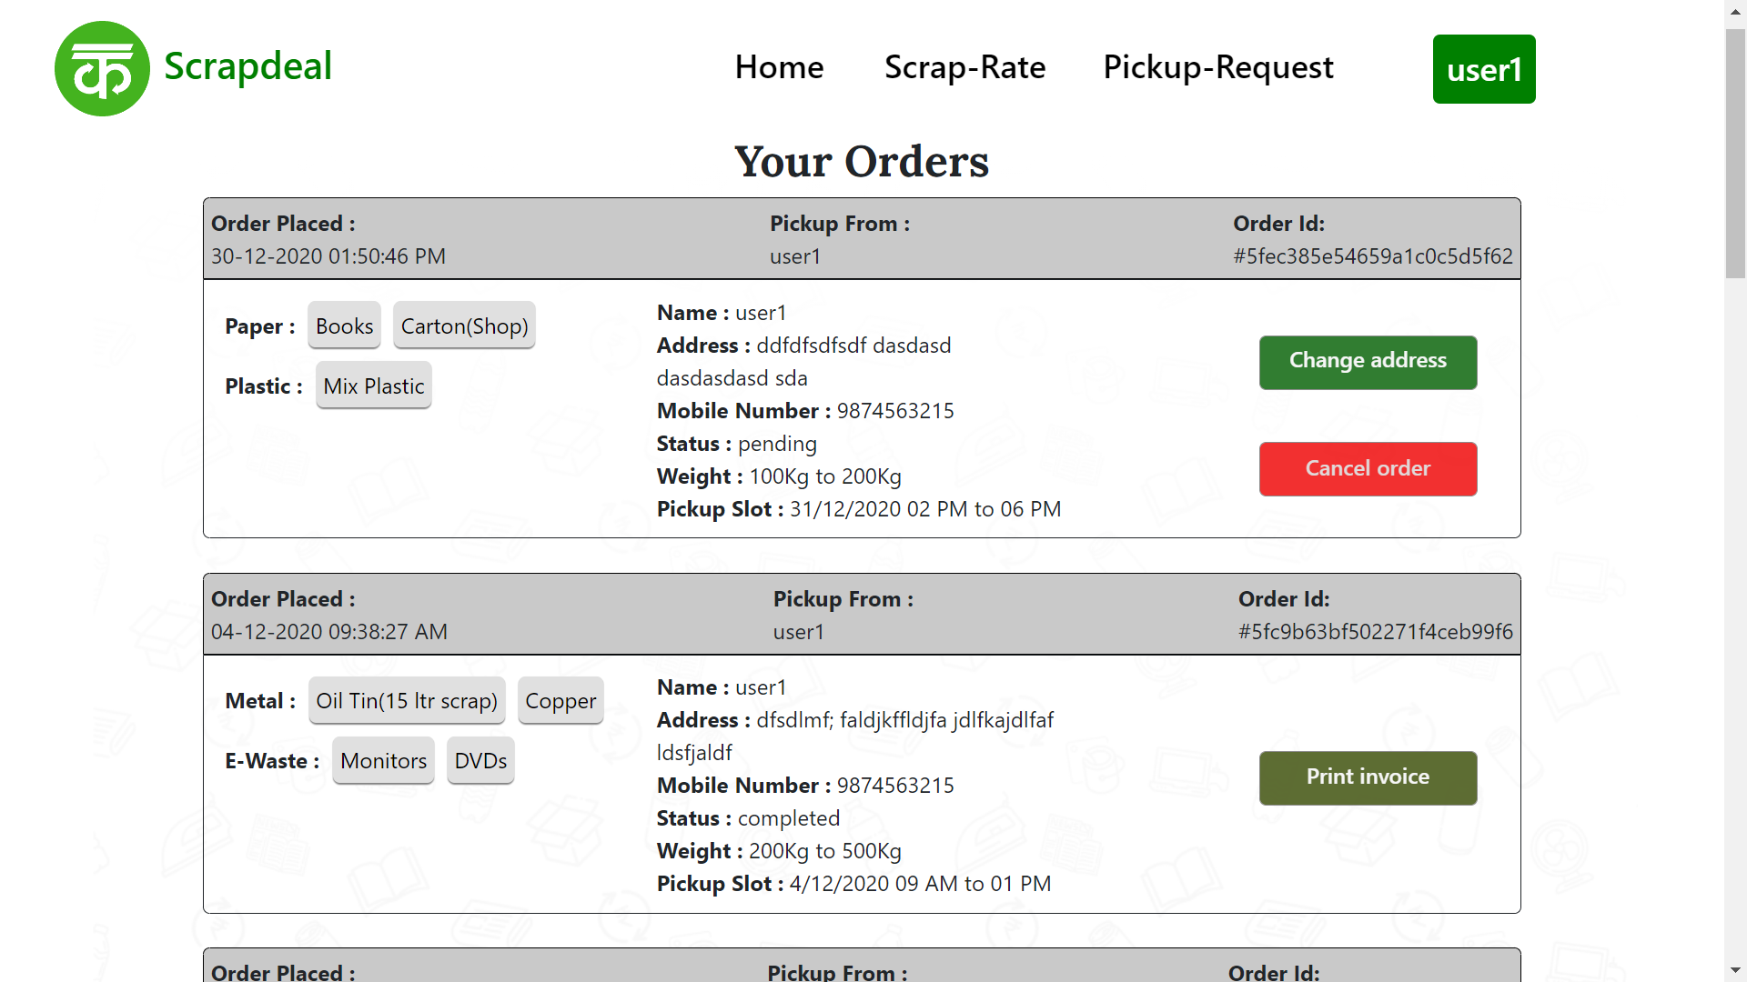
CONTINUE…

Slide 29
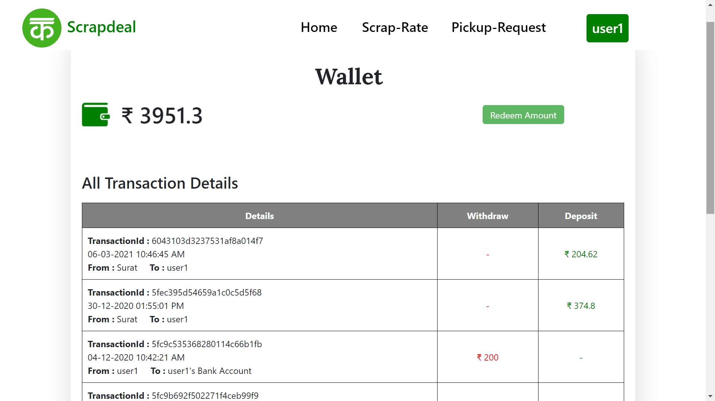
CONTINUE…

Slide 30
Conclusion
TO Conclude, ScrapDeal mainly focuses on Customer Relaxation by providing them an web application that can be used to select the scraps, book an collector and sell them without travelling anywhere in search of a scrap collector which will be beneficial in both time and resource optimization.

Slide 31
THANK YOU

